Slide 1
Detection of Cyberbullying Incidents on Instagram Social Network
Presented By:
A 12 Chinmay Gaikwad
A 72 Pratik Ziman

Slide 2
Content
Introduction
Previous presentation summary
Research on our topic
Implementation
Conclusion

Slide 3
Introduction
Cyberbullying is when a intended person uses the internet, cell phones, or other devices to send or post text or images intended to hurt, embarrass,threaten, humiliate, or intimidate their victim.
Cyber bullying is carried out through electronic technologies which includes devices and equipment such as cell phones, computers, and tablets.
Most common platforms includes Instagram 42%, Facebook 37%, Snapchat 31%, Whatsapp 12%, Twitter 9%.

Slide 4
Previous Presentation Summary
In previous presentation we had given an idea about our topic i.e Detection of Cyberbullying Incidents on Instagram and how it is to be done.
Features and purpose of our project.
Various technologies used in our project.
And for better understanding we had referred IEEE papers which were similar to our topic.

Slide 5
Research on following topics
Block Diagram Of Training data
Creating a data scraping model
Import Data From Instagram
storing scraped data into excel sheet
Crating sentiment analysis model
Implementation

Slide 6
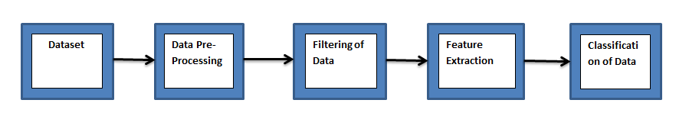
Block Diagram of Training Data

Slide 7
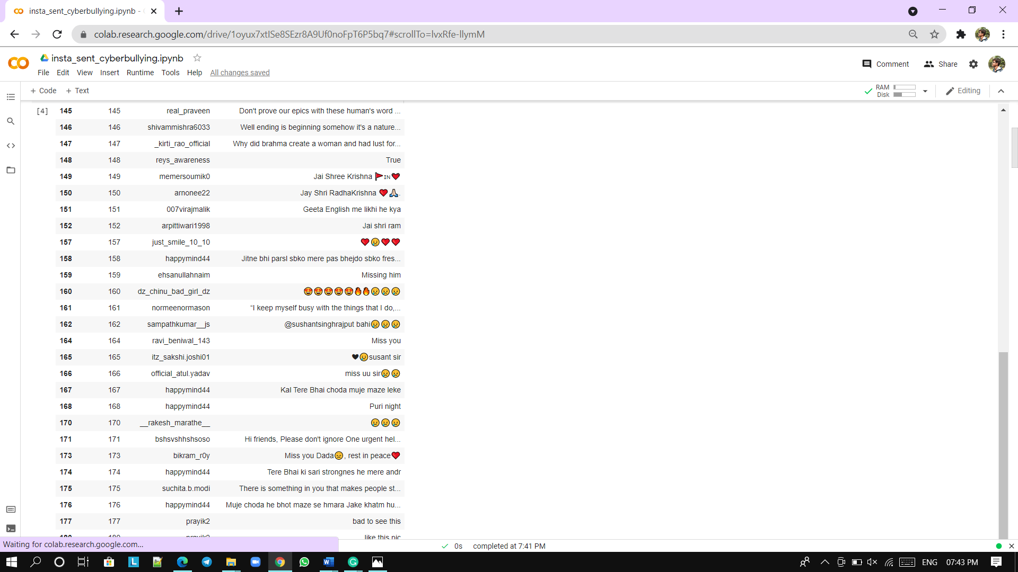
DATA COLLECTION
Fig:- data collected from various posts

Slide 8
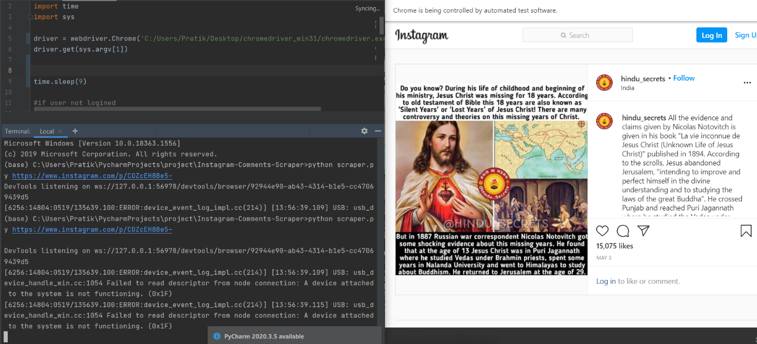
SCREENSHOTS

Slide 9
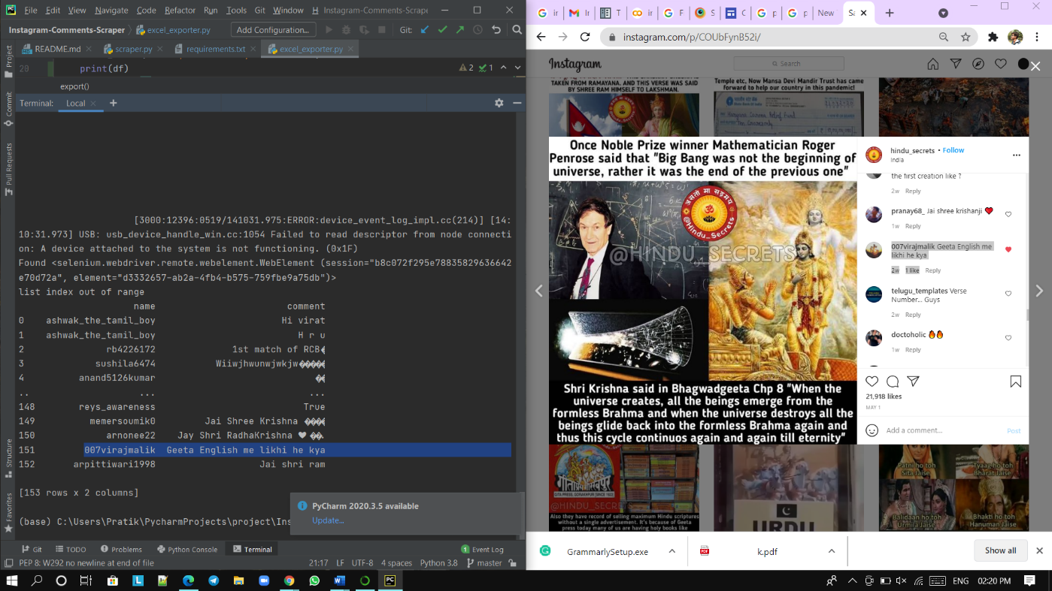

Slide 10
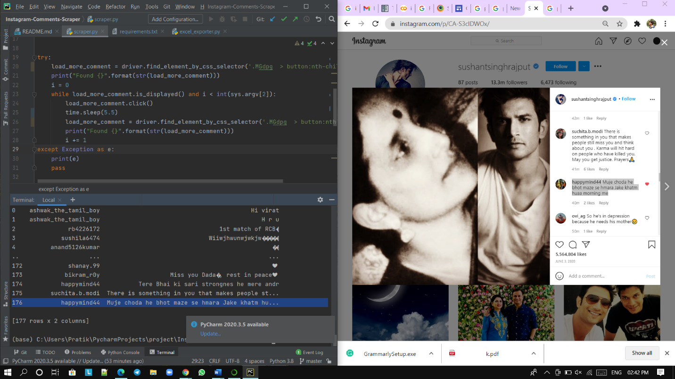
Fig: collecting data from post

Slide 11
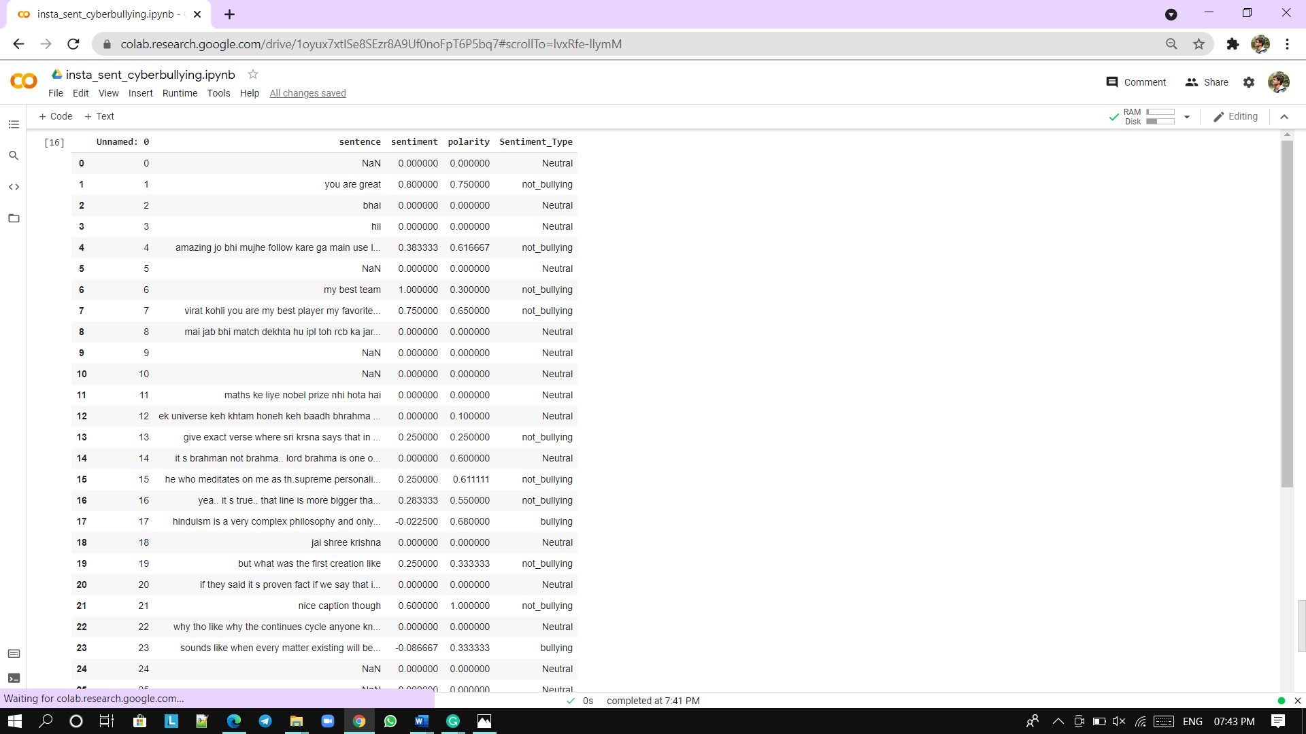
Fig: classification into sentence type

Slide 12
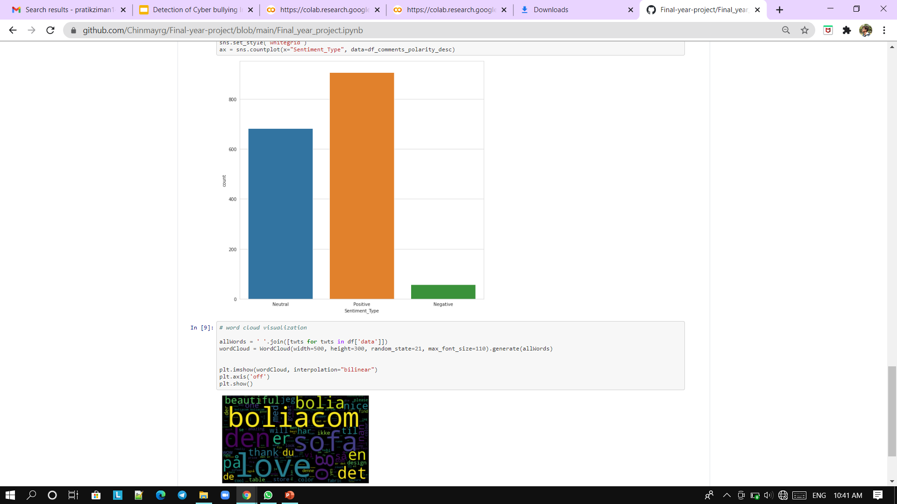
Fig: Graphical representation of data

Slide 13
Conclusion
Cyberbullying is a serious issue, and likely any form of bullying it can have long term effects on its victims. Our project will grow and help individuals to be aware of Cyberbullies. Parents, teachers and children must work together to prevent cyberbullying and to make Internet a safer place for all.

Slide 14
Reference
https://www.youtube.com/watch?v=0aXXJ4IPKfE
https://developers.facebook.com/docs/instagram-basic-display-api
https://developers.facebook.com/docs/instagram-api/guides/comment- moderation/
https://www.instagram.com/accounts/manage_access/
https://developers.facebook.com/docs/instagram-basic-display-api/guides/ getting-access-tokens-and-permissions/

Slide 15
Thank you!

